Slide 1
US Census Data

Slide 2
We retrieved data from US Census API that covered the years from 2012-2016.
The data obtained described various socioeconomic parameters for each state.
Unemployment and Poverty rates for each state were computed and plotted.

Slide 3
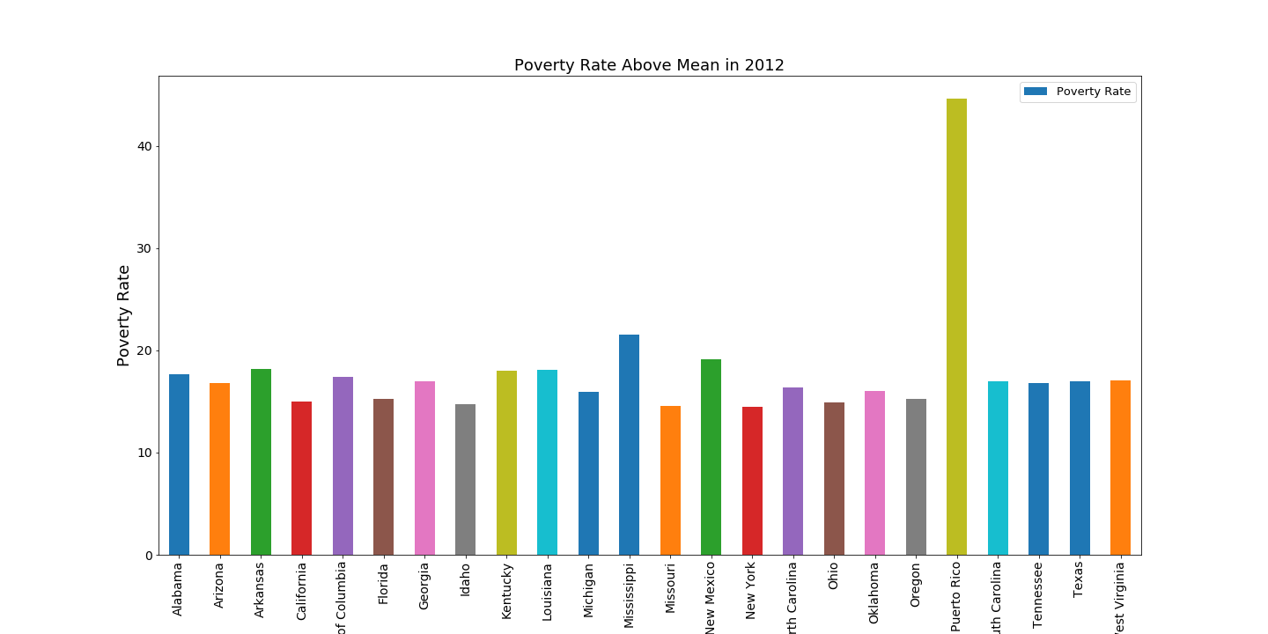

Slide 4
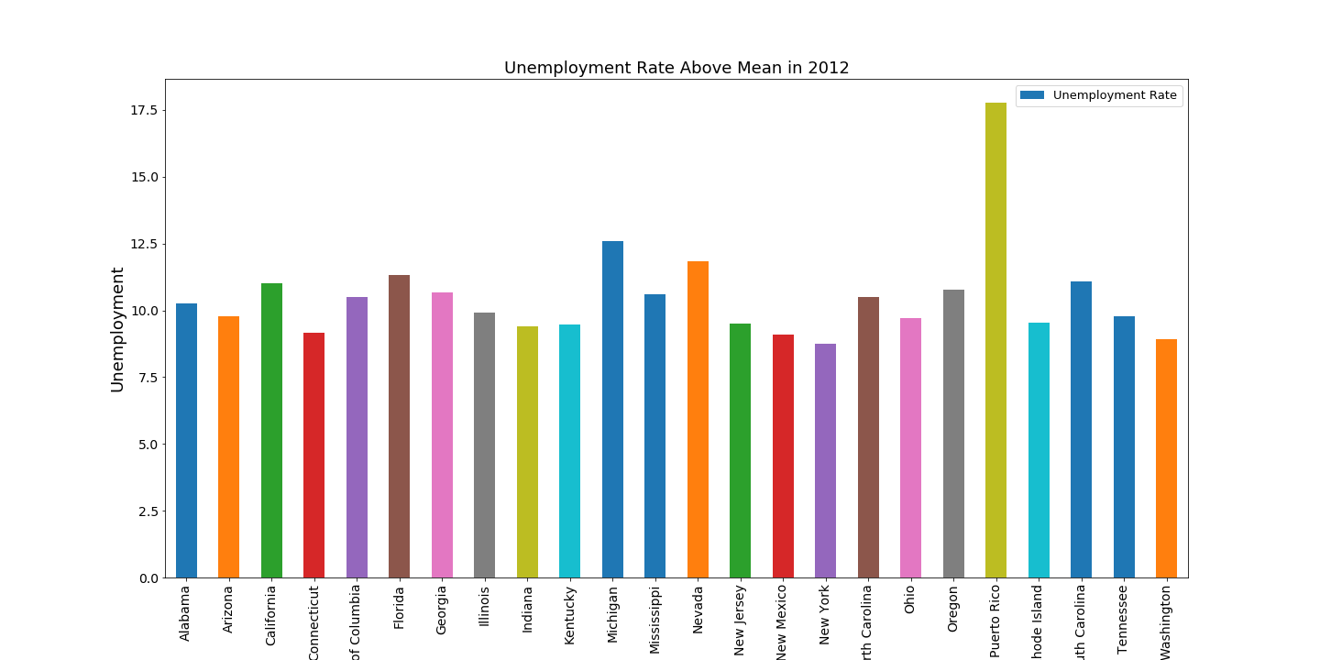

Slide 5
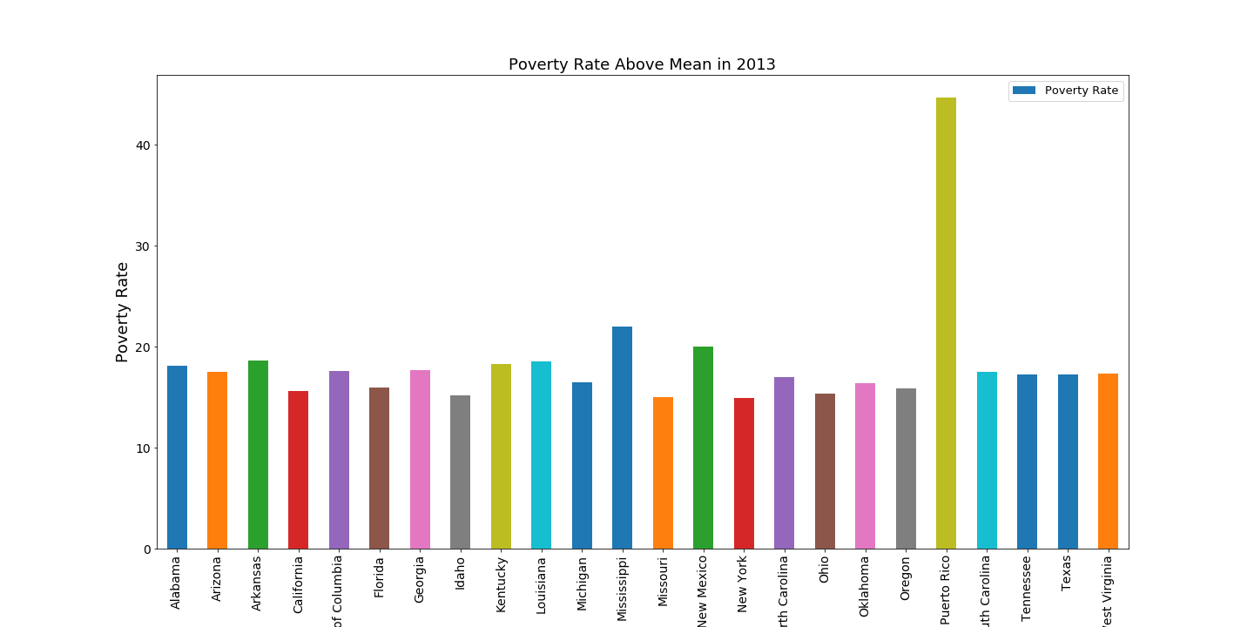

Slide 6
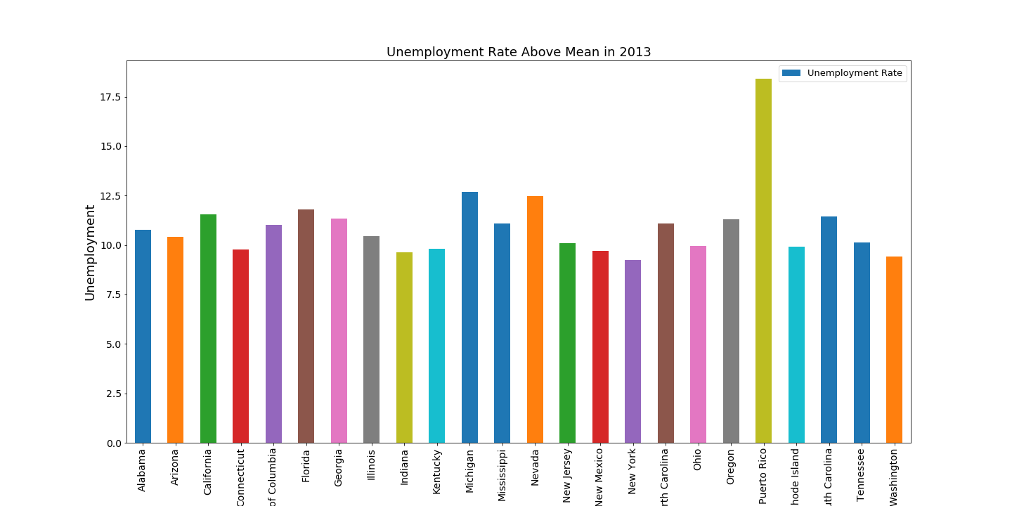

Slide 7
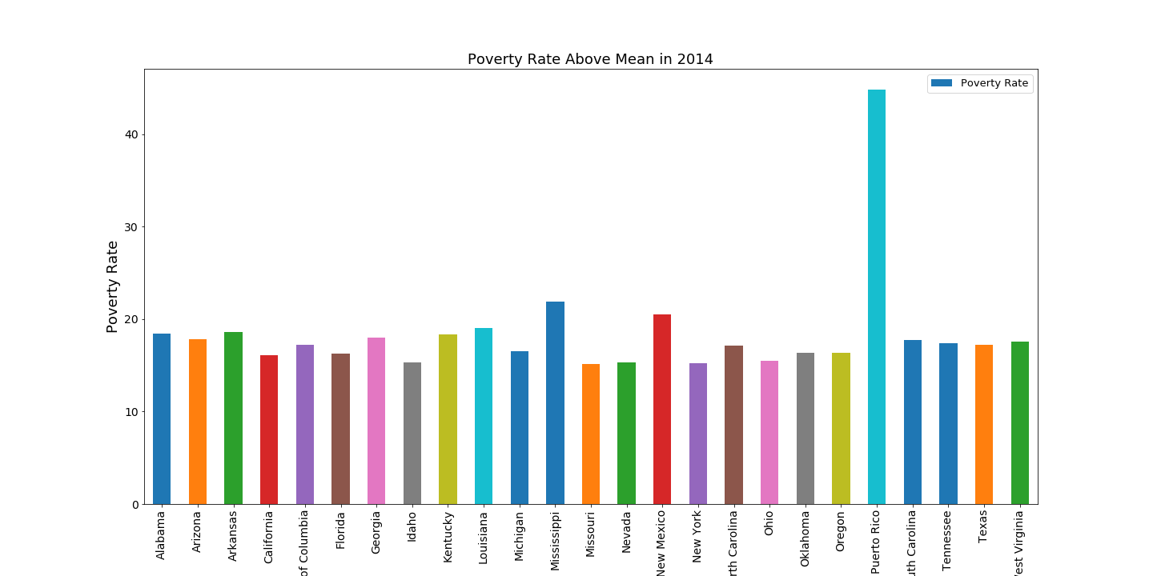

Slide 8
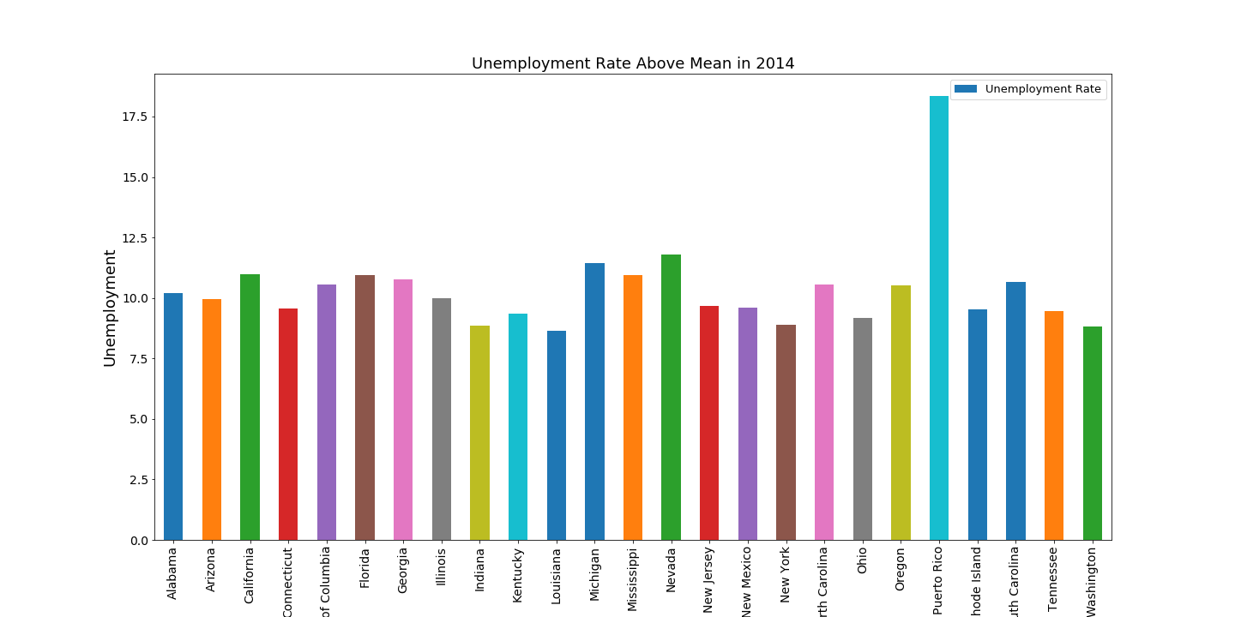

Slide 9


Slide 10
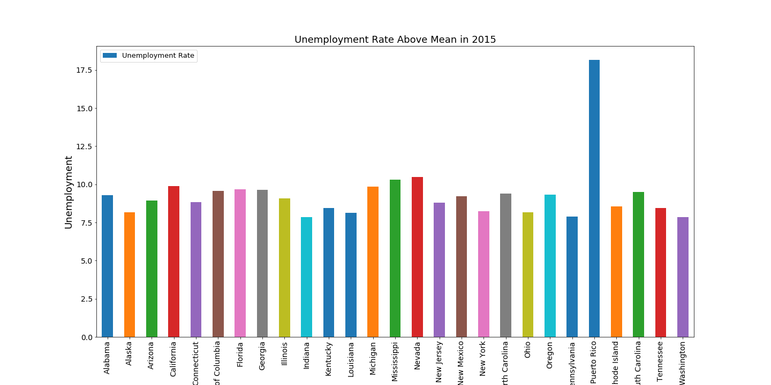

Slide 11
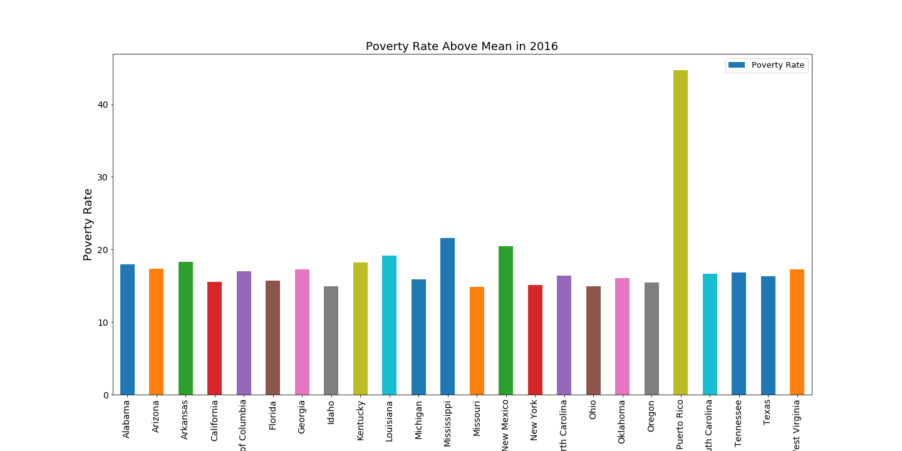

Slide 12
